Slide 1
LIS4761 MINING
COVID-19 DATA IN FL
GROUP THREE
JADYN HOLLAR VERONICA VACCARO KINGSLEY JOHN LYNDSEY GUIDASH KAYLEN TON

Slide 2
Table of contents
01
02
03
04
05
06
Introduction
EDA via R Shiny
Regression
Topic & research questions.
Exploring different variables in the dataset.
Examining the relationship between FL county factors and COVID rates.
Topic Modeling
Sentiment
Conclusions
Uncovering the most prominent covid-related topics in 2020 and 2021.
Measures the tone of Florida Covid-19 tweets.
Final insights.

Slide 3
01
Introduction
Our project analyzes COVID-19 pandemic from both a public perception and data-driven perspective. We combined text mining and sentiment analysis of Twitter data with exploratory data analysis and regression modeling of Florida’s county-level COVID-19 data. We used two main datasets:
A Kaggle Twitter dataset with over 400,000 tweets across three time periods to study how public discussions and emotions about COVID-19 changed over time.
A Florida county-level dataset from the U.S. COVID-19 library, which includes variables such as new percent positive cases, deaths, testing rates, and median age, to explore factors related to infection rates.
Our research questions were:
How did major COVID-19 discussion topics and sentiments shift across different stages of the pandemic?
Which county-level factors best predict new percent positive COVID-19 rates in Florida?

Slide 4
Project Goal
Our goal is to understand how COVID-19 conversations shifted over time
We used three methods to study both public discussions and real county-level COVID data:
Topic Modeling (LDA): to uncover themes in tweets
Sentiment Analysis: to evaluate positive, negative and neutral language
Linear Regression: to examine how county factors relate to COVID positivity rates
Together these approaches give us a better picture of how the pandemic evolved publicly

Slide 5
Dataset Information
Twitter Dataset (Kaggle):
About 400,000 lines of data across three time periods:
Apr - Jun 2020
Aug - Sep 2020
Apr - Jun 2021
Includes original tweet text, hashtags, metadata, and basic engagement data
Florida COVID County Dataset:
County-level health metrics. The variables we selected for regression were:
COUNTYNAME
NewPercPos (new percent positive cases)
MedianAge
EverMon (ever monitored)
MonNow (monitored now)

Slide 6
Overview of Methods
Topic Modeling (LDA)
Found common themes in tweets
Tested multiple counts using coherence/perplexity
Compared how topics shifted across the three COVID periods
Sentiment Analysis
We analyzed tweet emotion using the Bing sentiment lexicon that classifies tweet as positive or negative
Classified tweets as positive, negative or neutral
Linear Regression
Modeled NewPerPos using county variables (MedianAge, EverMon, MonNow)
Interpreted predictor relationships and overall model fit
Used scatterplots and model outputs for evaluation

Slide 7
Data Cleaning
Twitter Data Cleaning
We removed URLs, emojis, repeated punctuation, and duplicated tweets.
Lowercase all text and removed stopwords
Combined all three periods and prepared cleaned text for topic modeling and sentiment scoring
Florida County Data Cleaning
Selected the five variables used in the regression
Removed missing values to create a complete dataset
Ensured predictor variables were numeric and consistent

Slide 8
02
Exploratory Analysis
VERONICA VACCARO

Slide 9

Exploratory Data Analysis with Shiny
Exploratory Data Analytics (EDA) helps uncover patterns, trends, and relationships in a dataset before applying advanced models.
With R Shiny, this process becomes interactive, allowing users to dynamically explore variables and visualize results in real time.
Supports understanding of COVID-19 patterns across Florida counties through customizable charts and comparisons.
Makes data insights accessible without manual coding. Users can select metrics, compare variables, and visualize distributions.
This analysis reveals which counties have the highest infection rates, how positivity varies with age and deaths, and whether the population factors relate to case severity.
Load and Clean Data
Select Metrics
Visualize Patterns
Compare Variables
Interpret Insights

Slide 10
Workflow
Preparing the data
Imported Florida COVID-19 county dataset (filtered out invalid rows like “A State”)
Selected Key variables (cases, deaths, testing, monitoring, age)
Removed missing values using na.omit()
Building the Shiny App
Created dropdowns and sliders for dynamic metric selection
Set up tabs for:
Overview - top counties by chosen metric
Distribution - histogram + density curve
Compare - scatter plot comparing two metrics
Interacting with the data
Users can choose:
metric to explore (deaths, new percent positive, etc),
X/Y variables to compare,
Point size/color to add dimensions

Slide 11
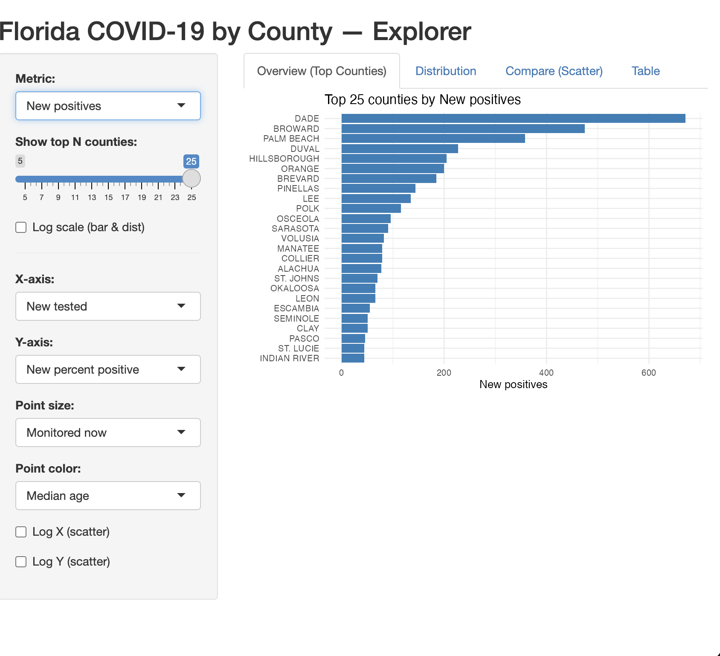
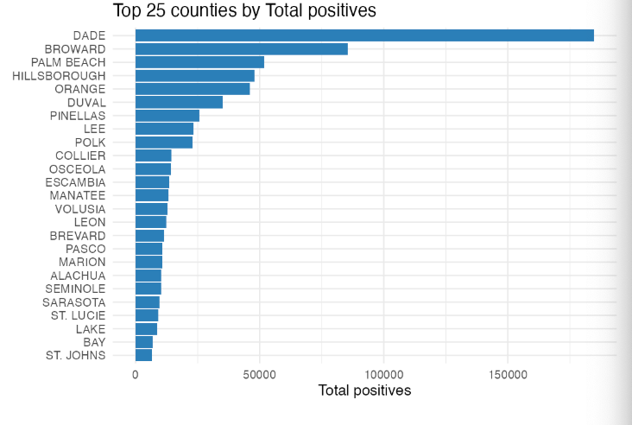
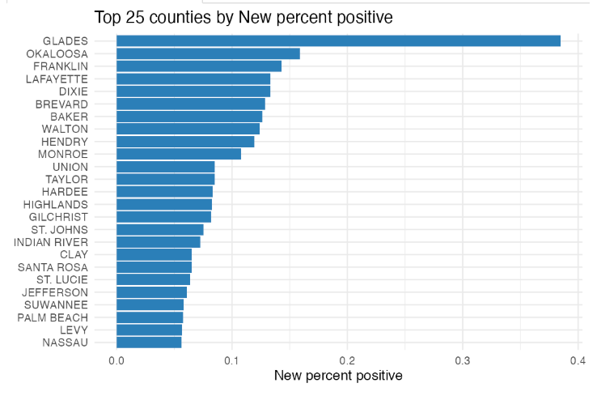
Top 25 Counties
Total positives are highest in big, urban counties (Dade, Broward, Palm Beach),
Reflecting population size and extensive testing
New percent positive highlights smaller or rural counties (Glades, Okaloosa, Franklin)
Suggesting local outbreak surges or limited testing capacity (few people being tested but many positive)
Larger counties show lower percent positive because they conduct more tests

Slide 12
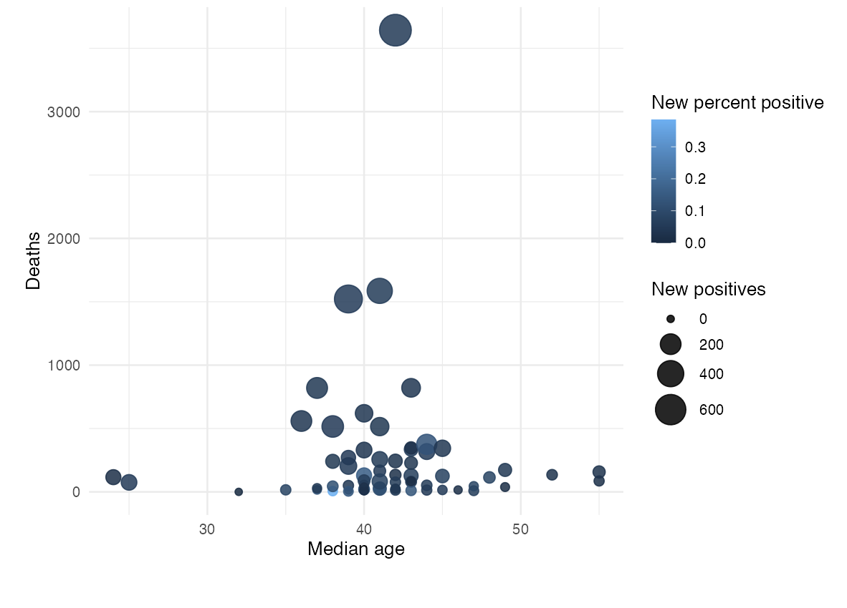
Comparing Different Metrics by County
Most counties cluster around a median age of 35- 45
These counties generally show moderate death counts and moderate new positives.
Counties with highest deaths tend to have slightly older mean ages, many new positives, higher positivity rates.
This suggests that older, more populous counties experienced both higher spread and higher mortality.
Younger counties generally had fewer deaths and fewer cases overall.
No strong linear trend.
Visible cluster showing higher deaths where median age and case counts are higher.

Slide 13
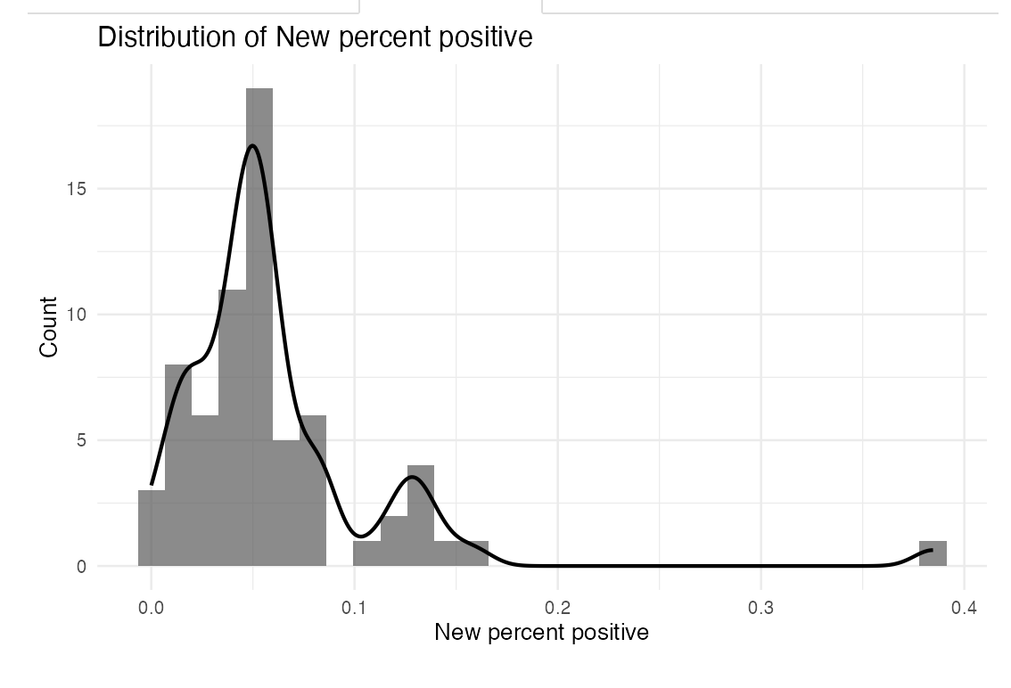
Distribution of New Percent Positive
Most counties cluster around lower positivity rates (around 0.05-0.08, or 5-8%).
The distribution is right-skewed, meaning a few counties have much higher positivity rates, up to around 0.4 (40%).
The small second bump around 0.12 might indicate a small subgroup of counties with moderately higher rates.
Outliers on the far right likely represent smaller or rural counties with fewer tests, where even a few positive cases inflate the positivity percentage.

Slide 14
03
Linear Regression
KINGSLEY JOHN

Slide 15
Linear Regression
Purpose:
To examine whether county-level factors are related to the New Percent Positive COVID-19 rate in Florida.
Variables Utilized:
Outcome: y-intercept
NewPerPos
Predictors: x-intercept
MedianAge
EverMon(ever monitored)
MonNow(currently monitored)
Process:
Cleaned and selected the necessary numeric variables
Built a simple regression model using Florida county data
Checked coefficient direction, strength and significance
Used scatterplots and fitted lines to visualize relationships

Slide 16
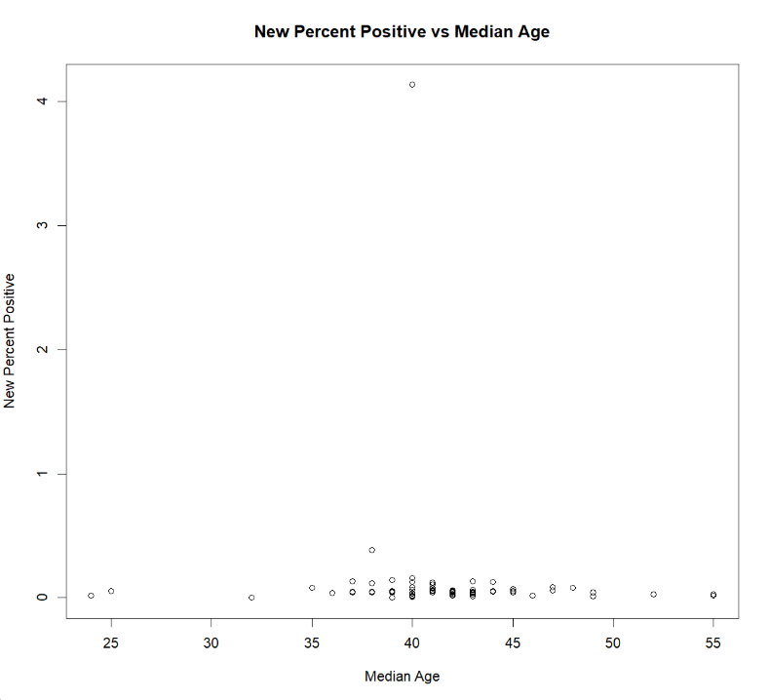
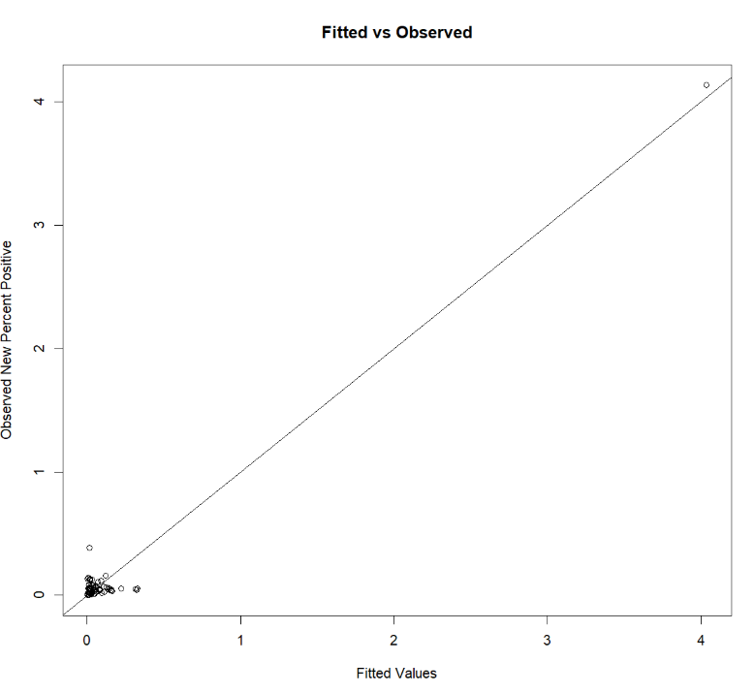
Linear Regression Continued…
Interpretation:
Some predictors show meaningful relationships with New Percent Positive, especially Median Age, which displayed a clearer pattern compared to the monitoring variables.
Regression helps highlight which county characteristics align with higher or lower positivity rates
Visual checks (residuals, scatterplots) support understanding model fit.

Slide 17
04
Topic Modeling
KAYLEN TON

Slide 18
Workflow
Preparing the data
tidyverse, tidytext, qdap, tm, SnowballC, topicmodels
Cleaning the tweets, tokenizing the words, stemming + stem completion
tidy(matrix = “beta”)
Trial-and-error’d several different k values, proceeding with the model which gave the most humanly interpretable results
tidy(matrix = “gamma”)
Determined the most overall talked about topics during April - June in 2020 and 2021 by assigning topics based off highest gamma per document

Slide 19
Preparing The Data (PT.1)
Original tweet:
@ayemojubar We have lost 3 healthcare workers: Dr Emeka, Dr(PT) Otegbeye and Dr Aminu...yet some still think COVID-… https://t.co/u04st9avXw
Semi-cleaned tweet:
We have lost three healthcare workers Dr Emeka DrPT Otegbeye and Dr Aminuyet some still think COVID…
Then:
Tokenizing using unnest_tokens()
Removing stop words using anti_join()

Slide 20
Preparing The Data (PT.2)
1) Word Stemming & Stem Completion
Created a dictionary, pulling distinct words from the cleaned, tokenized dataframe
wordStem() - breaking the words into their roots
stemCompletion() - using the dictionary as reference to complete the words
Some words did not stem-complete the way I hoped, so I manually changed them using mutate() and recode().
2) Counting: 3) Creating DTM:
count(id, word) cast_dtm(id, word, n)

Slide 21
Latent Dirichlet Allocation
An unsupervised machine learning topic modeling technique.
It intends to uncover topics and themes which exist in and characterize the documents / text data.

Slide 22
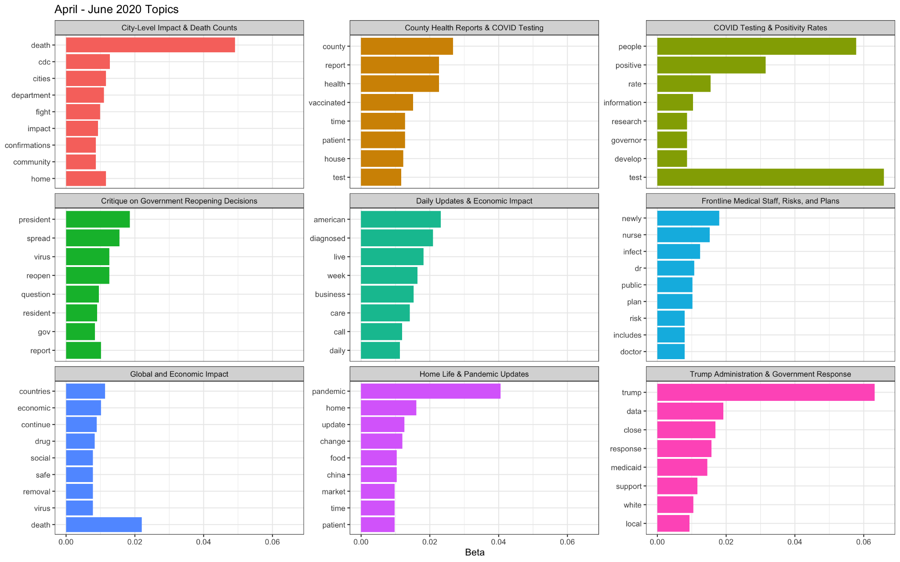

Slide 23
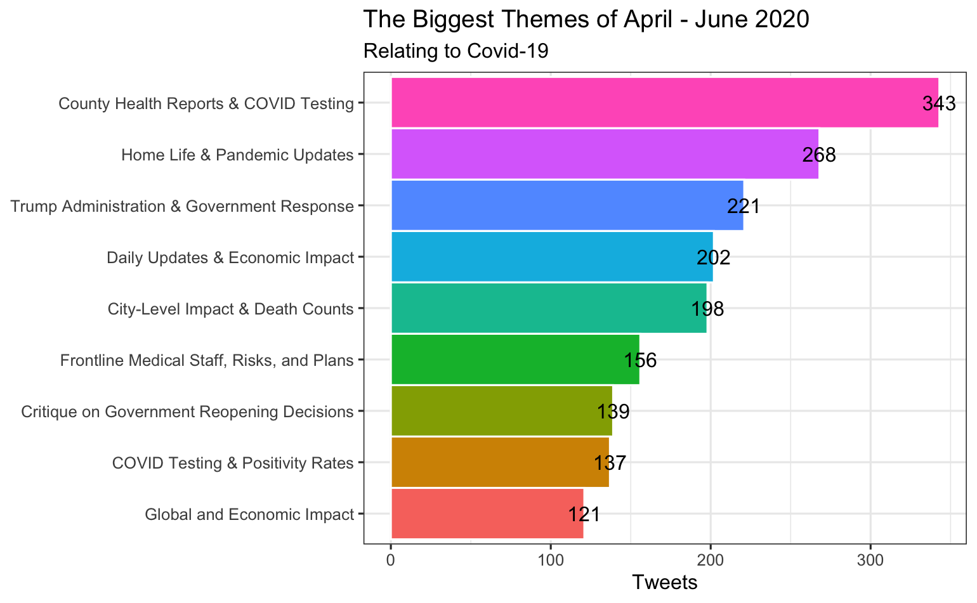

Slide 24
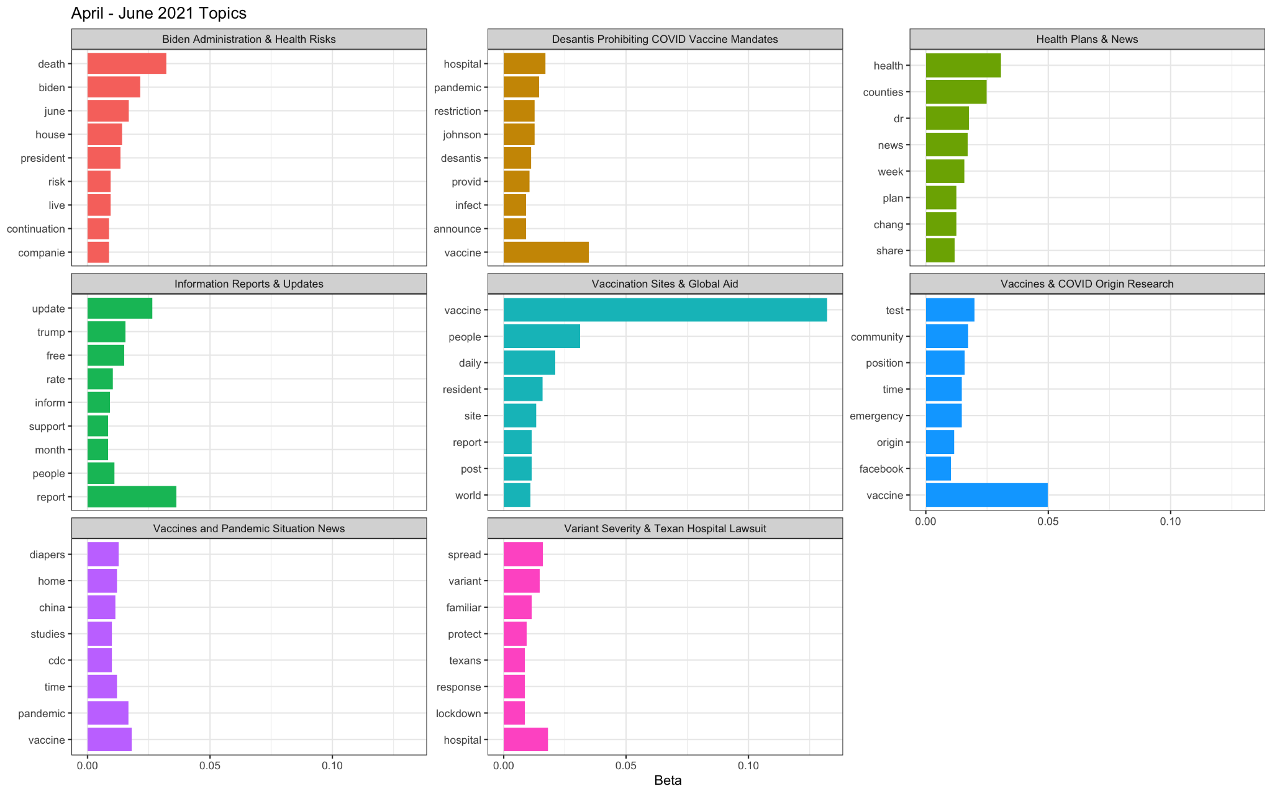

Slide 25
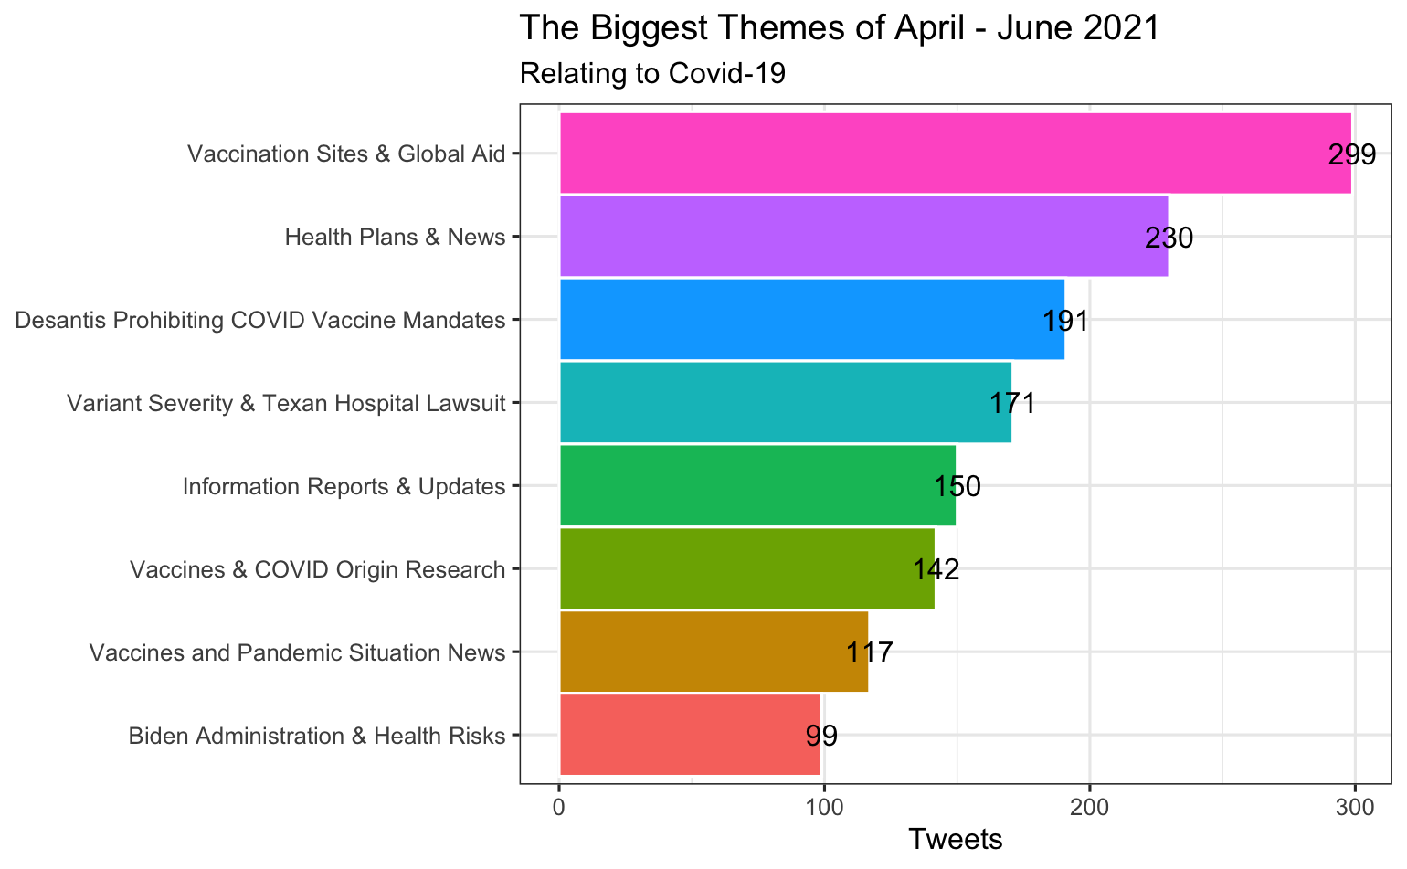

Slide 26
LDA INSIGHTS
For 2020, the strongest themes regarded health and test reports, pandemic updates, and government response. However, for 2021, we can observe the theme of vaccines dominating most topics.

Slide 27
05
Sentiment Analysis
LYNDSEY GUIDASH

Slide 28
Sentiment Analysis
Sentiment analysis uses natural language processing to detect emotions, attitudes, or opinions in text.
Helps researchers and organizations understand public mood and track trends, which in turn allows them solve issues more efficiently
This analysis reveals shifts in public mood over time, identifies language divided by positive and negative, and is good decision-making support in health and customer service.
Collects text data
Preprocess text
Apply sentiment models
Classify sentiment
Visualize results

Slide 29
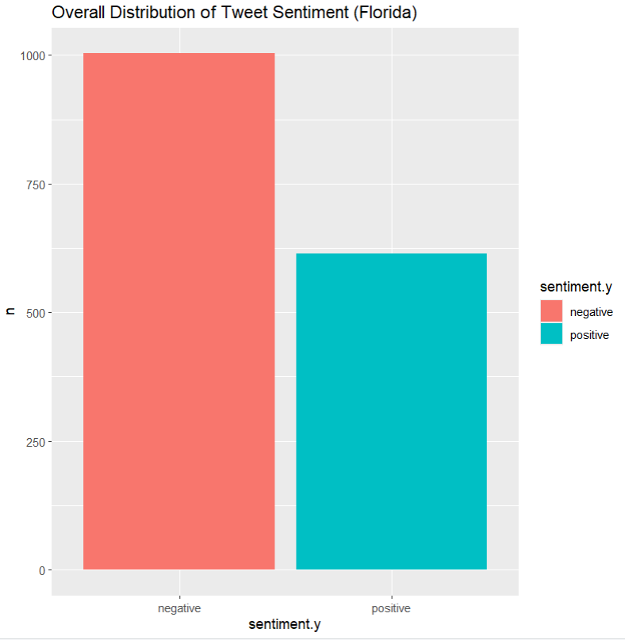
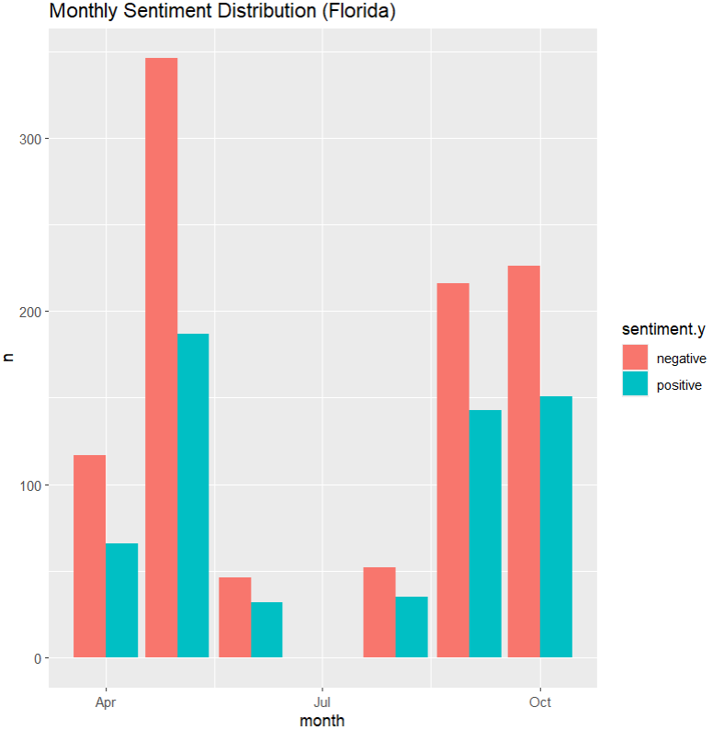
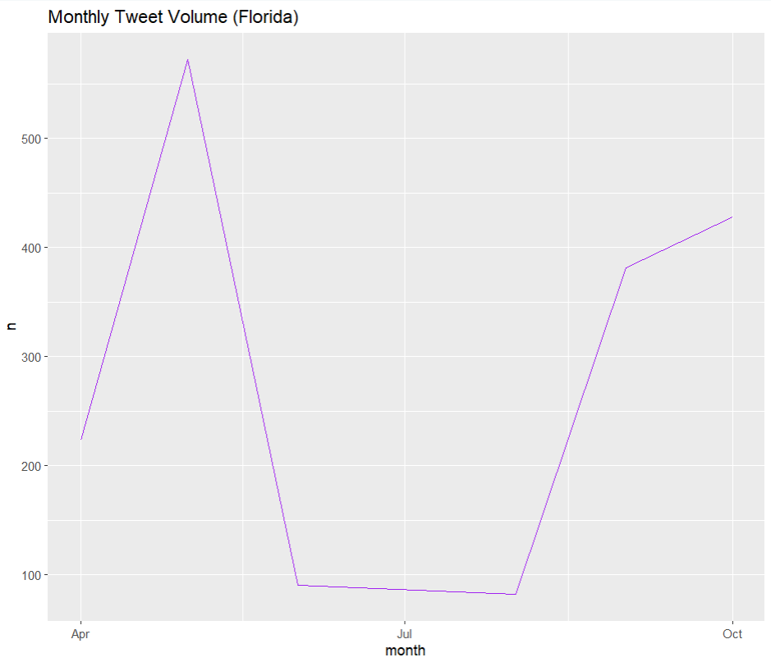
Workflow
Collected tweets from April to September 2020 datasets
Filtered for tweets made in Florida
Preprocessed text:
Tokenization, lowercasing, lemmatization, stopword removal
Applied Bing sentiment to categorize words as positive or negative

Slide 30
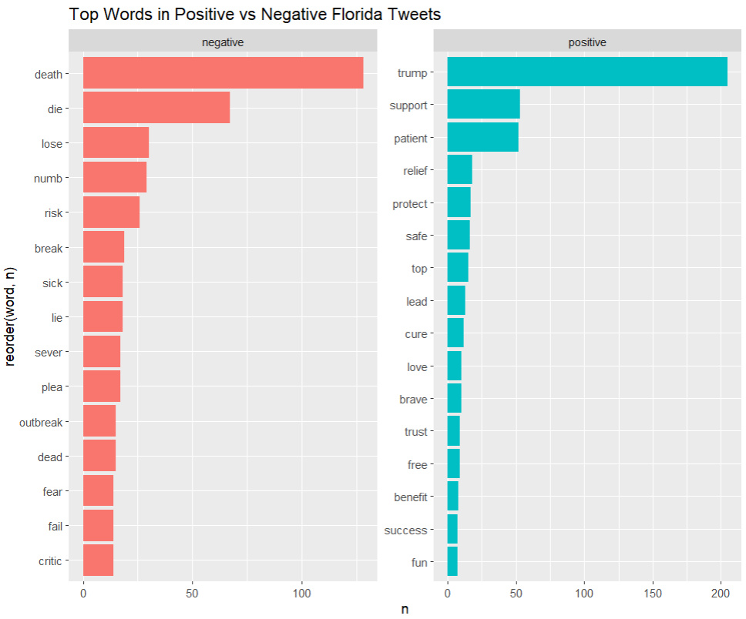
Insights and Takeaways
There were initially some issues with the data at first like certain words didn’t match lexicon until lemmatization was applied, and emojis and other excess noise needed to be filtered out.
Sentiment analysis is able to provide a high-level view but it requires careful preprocessing. The visualizations make trends and themes more obvious to any audience.

Slide 31
06
Conclusion
JADYN HOLLAR

Slide 32
Patterns / Insights
Exploratory Analysis
Large urban counties had the highest total COVID cases
Smaller rural counties often had higher percent positives
Most counties clustered around similar median ages
Counties with older populations tended to show higher deaths
Linear Regression
Median Age showed the strongest relationship with New Percent Positive which shows that older demographic tended to have higher positive rates
EverMon and MonNow did not truly predict positive rates, proving that age is a key driver behind the COVID cases in the counties.
Topic Modeling
2020 tweets focused on Covid’s severity and commentary on government responses.
2021 tweets shifted focus toward vaccines, with a strong pushback against mandates.

Slide 33
Final Insights
Why This Matters
Shows how public priorities shifted over time
Helps explain why certain areas experienced higher risk
Shows how different communities were affected differently
Real World Use
Data like this can help officials respond faster to public concerns
Can be used for future outbreaks and help with planning for emergency situations similar to COVID

